Slide 1
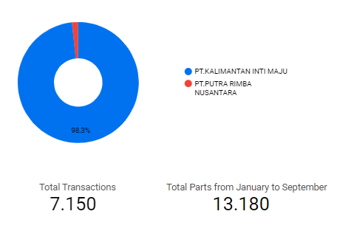
Total Transactions from January to September
Out of the total 7,150 transactions conducted, we have dispatched a total of 13,180 parts.
From these transactions, 98.3% or 7,033 transactions belong to PT Kalimantan Inti Maju, while 1.7%, or 117 transactions, come from PT Putra Rimba Nusantara.

Slide 2
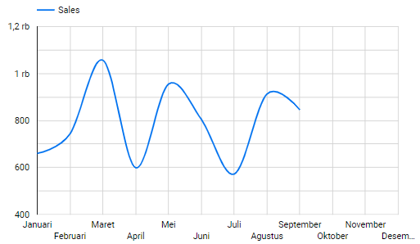
Monthly Sales Chart from January to September
March recorded the highest sales with 1,057 transactions. Meanwhile, the lowest sales were in July, totaling 572 transactions.

Slide 3
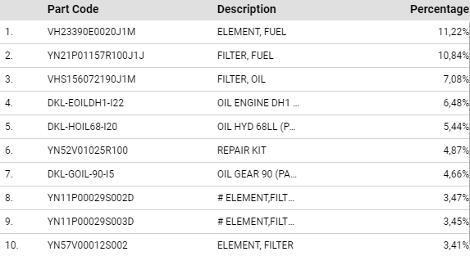
Top 10 Part Sales from January to September
Here is the list of parts sold from 7,150 transactions, totaling 13,180 parts.

Slide 4
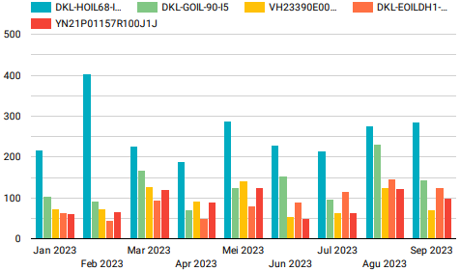
Top 5 Code Part / Month
Here are the colors and their descriptions:
Blue = DKL-HOIL68-I20
Green = DKL-GOIL-90-I5
Yellow = VH23390E0020J1M
Orange = DKL-EOILDH1-I22
Red = YN21P01157R100J1J

Slide 5
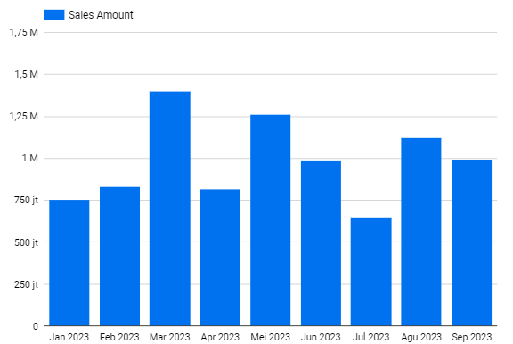
Monthly Profit Margins
Profit Margins per Month:
January = Rp 758,799,956.00
February = Rp 833,006,491.00
March = Rp 1,402,143,404.00
April = Rp 818,347,611.00
May = Rp 1,263,521,006.00
June = Rp 986,455,200.00
July = Rp 647,688,600.00
August = Rp 1,122,467,200.00
September = Rp 994,912,500.00

